Slide 1

<MACHINE LEARNING-BASED CATEGORIZATION OF RACISM IN AMHARIC TEXT USING MULTI-CLASS CLASSIFICATION>
<Abebe Desie, Million Meshesha>
<Abebe Desie>
5th International Conference on ICT for Development for Africa (ICT4DA-2023)

Slide 2
Introduction
In today's digital era, the widespread use of mobile phones and social media has reached unprecedented levels.
In Ethiopia alone, investigated that there are approximately 21.14 million users, actively engaging on popular social media platforms such as Facebook and Telegram [3].
Social media has emerged as a vital communication tool, serving as a platform for news dissemination and raising social awareness [4].

Slide 3
...cont’d
These platforms have become to support spread of valuable sources of data on social media.
Such data's are contain both necessarily and un-necessarily to social media users.
The Amharic language is a vital component of this trend. It is spoken by up to 35 million Ethiopians which is almost one-third of the population by Bowling [5] investigated.
However, this spread of un-necessarily data poses a challenge as it allows for the propagation of racism on ...

Slide 4
...cont’d
Racist comments and posts are affect economical, political and social phenomena's.
The researchers are to employ machine learning and deep learning algorithms to categorizing Amharic text racist comments and posts on social media. Such texts are categorized into individual, regional, and country-racist contents.

Slide 5
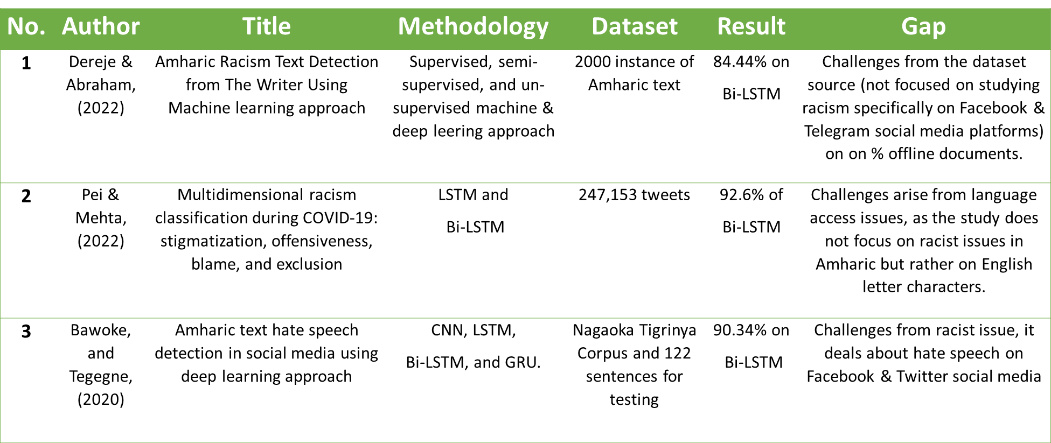
II. Related Work

Slide 6
...cont’d
Tesfaye & Tune developed a recurrent neural network (RNN) model for automatic hate speech classification in Amharic text on social media.
Pei & Mehta developed a multidimensional model for racism detection on social media, categorizing racist acts into stigmatization, offensiveness, blame, and exclusion.

Slide 7
...cont’d
Based on related research, a gap exists in addressing racism through text classification in the Amharic language.
While there are studies on detecting hate speech, none specifically analyze racist text in Amharic.
Given the growing prevalence of racism in Amharic text on social media, further research is needed to bridge these gaps and gain a comprehensive understanding of racism, its expressions, and effective classification techniques in the Amharic context

Slide 8
Methodology
In this research, experimental research design is employed, because it helps to conduct research in a controlled and objective manner to ensure that precision is maximized and the experimental result can be used to draw specific conclusions.
It also helps us to investigate the possible cause-and-effect relationships by utilizing one or more experimental groups and comparing the results of machine learning(ML) algorithms.

Slide 9
Data Collection
The data collection process followed specific criteria, including
Why the source is selected
What types of data are collected
Where the data is collected
How the data is collected
What type of method is used for data collection

Slide 10
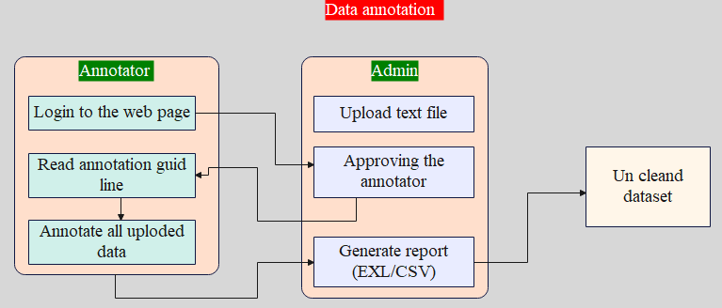
Data Annotation

Slide 11
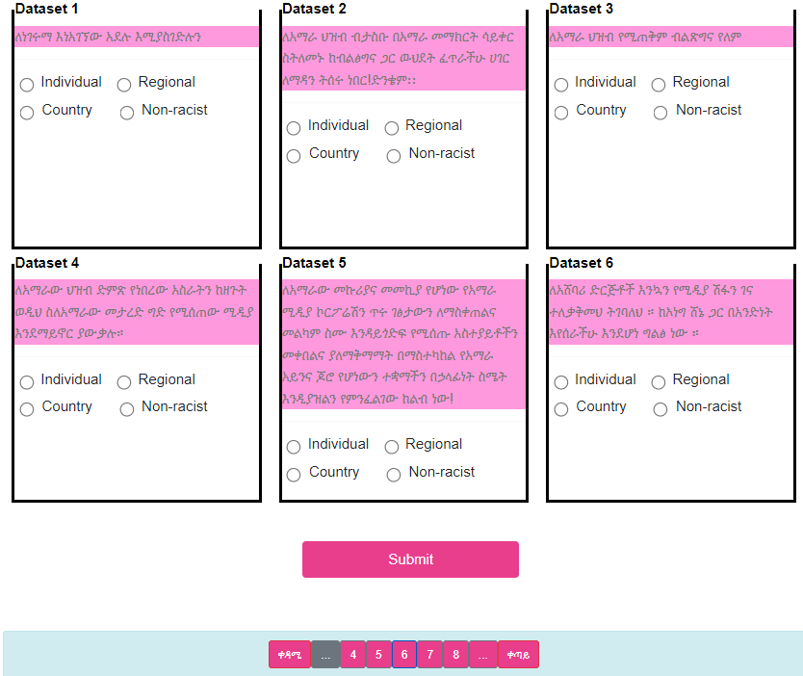
Annotation Web Form

Slide 12
Data Preprocessing
The preprocessing activities in this research include data cleaning, stop word removal, padding, normalization, and tokenization.
By applying these techniques, the research aims to optimize the dataset for analysis and classification.
This process allows supervised machine learning and deep learning algorithms to better understand and learn patterns from the preprocessed text data, thereby improving the accuracy and performance of the classification model.

Slide 13
Proposed Architecture
The proposed architecture deals about the following phases. The first phase comprises data collection .
Data is collected from different posted Amharic texts from social media plat forms like…
The second phase involves dataset preparation. It is an important task for data preprocessing (cleaning, data annotation…) and feature extraction (padding…). it is suitable for a machine-learning model.

Slide 14
...cont’d
The third phase, split the dataset into train and test.
The fourth phase uses the vectors obtained from the feature extraction phase to build the model.
In the final phase categorized the text into four classes of…

Slide 15
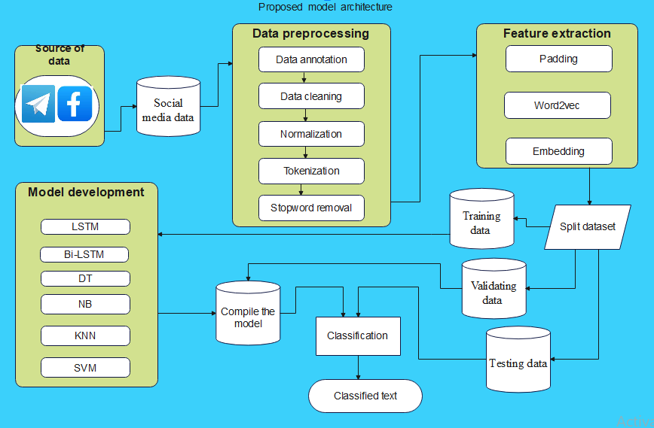
...cont’d

Slide 16
Model Evaluation
To present the performance of the classification model, confusion matrix and performance measurement metrics such as accuracy, precision, recall, and F-score.

Slide 17
Experimental Results and Discussion
The performance of each algorithm was evaluated by using precision, F1 score, and recall metrics of hyper-parameter.
To achieve this, several classification algorithms such as Naive Bayes, Support Vector Machines, k-Nearest Neighbors, and Decision Trees are investigated.
NBs algorithm can be tailored to better fit the characteristics of the given dataset, leading to improved results.

Slide 18
...cont’d
 | Precision | recall | F1-score | Accuracy | Model
NB | 78 | 96 | 88 | 78 | Selected
DT | 80 | 77 | 78 | 63
KNN | 78 | 97 | 87 | 76
SVM | 43 | 96 | 60 | 42

Slide 19
...cont’d
RNN algorithms like LSTM and Bi-LSTM are used to classify racist text in Amharic.
They utilize neural networks to identify patterns and features, and overcome the vanishing gradient problem in deep neural networks.
The experimental result depends on the accuracy, batch size, epoch and random state during training.

Slide 20
...cont’d
Models | Values | Value size | Validation | Accuracy | Loss value
BLSTM:1 | Batch | 50 | 0.1 | 0.9948 | 0.0269
 | Epoch | 8
BLSTM:2 | Batch | 128 | 0.1 | 0.9954 | 0.0180
 | Epoch | 10
BLSTM:3 | Batch | 128 | 0.2 | 0.9968 | 0.0129
 | Epoch | 10
BLSTM:4 | Batch | 5 | 0.2 | 0.964 | 0.0114
 | Epoch | 128
LSTM:1 | Batch | 32 | 0.15 | 0.9861 | 0.0171
 | Epoch | 30
LSTM:2 | Batch | 128 | 0.15 | 0.9710 | 0.1332
 | Epoch | 50
LSTM:3 | Batch | 128 | 0.2 | 0.9710 | 0.1332
 | Epoch | 10

Slide 21
Discussion of the result
The research findings reveal that the deep learning model exhibited superior performance compared to the supervised machine learning models.
Evaluation of the models involved assessing various metrics, including accuracy, recall, precision, and F-score.
The deep learning model achieved an impressive accuracy rate of over 99.46%, while the supervised machine learning models showed accuracy values of 78% and below.

Slide 22
...cont’d
Both experiments involved the development of supervised machine-learning algorithms for classifying racist Amharic text using labeled instances.
However, it is important to note that the order of data points holds significance in tasks involving sequential Amharic text data, which makes traditional supervised machine learning methods less optimal.

Slide 23
CONCLUSION
According to the research, racist texts on platforms like Facebook and Telegram plays a dominant role in negatively affecting users' lives by promoting conflicts based on race-related issues of individuals, regions, and countries.
The successful implementation of the model began with categorized racist texts, which encompass individual racism, regional racism, country racism, and non-racist language by using both recurrent neural network and supervised machine learning models.
Bi-LSTM model outperformed other RNN and supervised machine learning models in terms of efficiency and accuracy based on their hyper-parameters and evaluation metrics.

Slide 24
ዘረኝነት ይቁም!!!

